Slide 1
CNC Router
Lectures

Slide 2
Lessons
Lesson 1
  What is a CNC Router
  CNC Router Continued
  Industry Use
  For this class
Lesson 2
  Our shop CNC
  DEMO
Lesson 3
  Setting Up files
  Running the CNC DEMO
Lesson 4
  Files from the internet
  Files from your phone

Slide 3
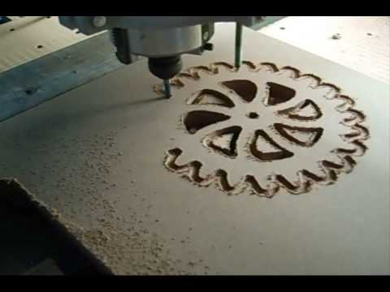
Lesson 1
Objectives
  Define CNC
  Define CNC router
  List the types of CNC machines we have in this class

Slide 4
What is a CNC Router?
What is CNC?
  CNC = Computer Numerical Control
    This is a set of numbered code that makes robotic sensors move in the way we manipulate the code
    Example: Telling the CNC router to move to the right is written as a numerical code
What is a CNC Router
  CNC Router = Computer Numerical Controlled Router
    This is a router that is attached to a robotic base

Slide 5
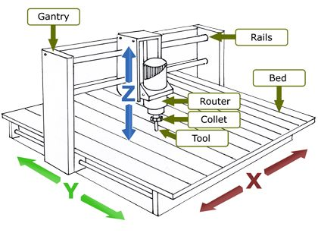
CNC Router Continued
Our CNC router
  3 axis
    X = forward and backwards
    Y = left and right
    Z = up and down
Most CNC routers are attached to a 3 axis system
System is controlled by a robotic box and motor
The Control box, or Spooler, is attached to the computer and it translates the code from the computer to operate the system.

Slide 6
CNCs in this Shop
CNC Router
CNC Lathe
CarveWright Carving Machine

Slide 7
CNC Machines and Industry
Used for large and small scale manufacturing
Used to cut multiple parts
Variety of machines
  CNC Mills
  CNC lathes
  CNC routers
Eliminates the need for many employees
Makes production faster with fewer mistakes
https://youtu.be/YJl9Jxi262g
CNC Machines in Industry
  Medical
  Stone/Masonry
  Welding/Metals
  Automotive
  Glass
  Plastics

Slide 8
Lesson 2
Objectives
  Learn how to operate and set up the CNC router in our shop
  Learn how to clean up the CNC router

Slide 9
Our CNC Router
CNC machines all operate differently it is important to understand how to operate a new machine BEFORE you actually use it.
Things to know about our CNC router
  The computer does not operate on the internet
    Files containing images must be placed on a thumb drive
  The computer does not require login information
    Click enter twice to login
  The CNC software is called EnRoute
  The CNC control is called StarCNC

Slide 10
DEMO
Please take notes based off of the in shop demo

Slide 11
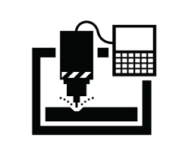
Lesson 3
Objectives
  Learn how to set up and save CNC files in EnRoute
  Learn how to open CNC files in StartCNC
  Learn how to run a file on the actual board.

Slide 12
Setting up the CNC in EnRoute
Open EnRoute 3 from desktop
Click File, New
  Set exact dimensions of your board
  Make sure that you orientate your board to proper X and Y dimensions
Design
Position and resize design
Insert font
  Click the Blue A
  Select font type
  Type text
  Resize
Repeat the steps if you have multiple images or text
Click and drag to select and highlight all of the images
  Vectorize the images
Click and drag to select all lines
Set up an Engraving tool path
Save file as
  YourLastName.CNCProject.Period.Date
  Example:
    Garner.Chessboard.3rd.3-15-17

Slide 13
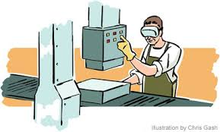
Set up Continued
Save file as
  YourLastName.CNCProject.Period.Date
  Example:
    Garner.Chessboard.3rd.3-15-17
Convert file to GCODE
  Machining
  Output
  To file
  Save file as
    Yourlastname_project
    Example:
      Garner_chessboard

Slide 14
Set up in Star CNC
Turn on CNC spooler (control box)
Open Star CNC on the Desktop
  Click “Okay” in the message box
Wait for spooler to initialize
  The thing will move around a bit
  Takes 10 seconds
Position your board on CNC machine
Jog the router so that the tip of the bit is BARELY touching the far top left corner

Slide 15
Set up Star CNC continued
Jog the router up (Z) so that it is almost touching the wood, but you can still place a piece of paper under it
Zero the Router
  Click “Set new Z position”
  Click “Set new XY position”
Open GCODE file
Practice RUN
Modify
RUN Final
It is important to practice run your pieces to see if you need to change the depth of the router
All directions for EnRoute and Star CNC are in the Blue Portfolio in the CNC cabinet.

Slide 16
DEMO
Take Notes Based off of the shop demo

Slide 17

Lesson 4
Objectives
  Learn how to transfer files from the internet to the EnRoute Software
  Learn how to transfer images from your phone to the EnRoute Softeware

Slide 18
Internet files
Find Desired image on the internet
  Make sure that the image as lots of contrast between the main image and background
Save the file as a JPEG under your account
Open the image in paint
Modify

Slide 19
The difference between Good Contrast and Bad Contrast
Good Contrast
- Dark lines differ from back ground
Bad Contrast
- There are no lines separating the main image from back ground
- Main image stands out
- No dark Spaces in back ground
- There are dark shapes in the background
- Dark Shapes in background connect to main image

Slide 20

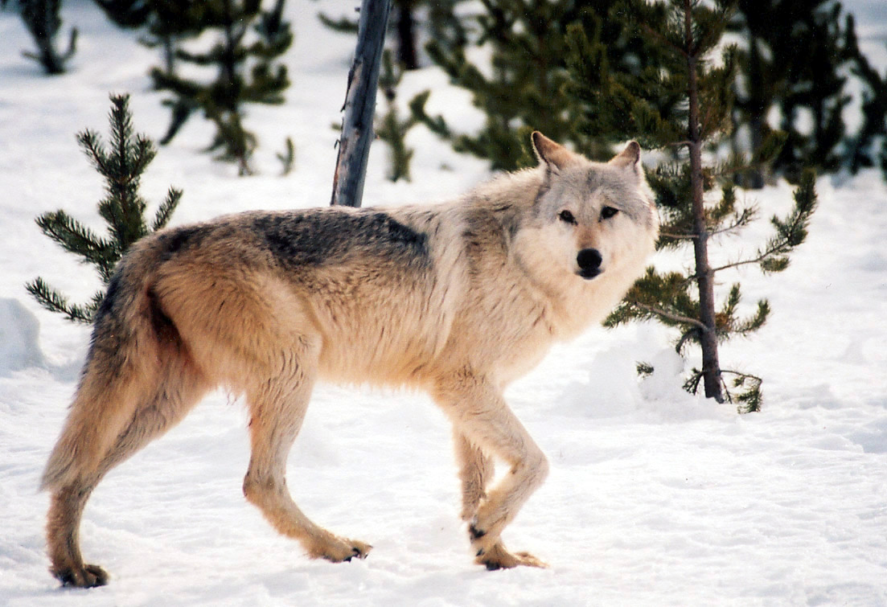
The differences Between Good and Bad Contrast
Good Contrast
Bad Contrast

Slide 21
Internet Files Continued
Save the file again as a JPEG
Save the file on the thumb drive as a BITMAP
  BITMAP files are the only files that can be ran on the CNC router
  Save as:
    Yourlastname.project.image
    Example:
      Garner.chessboard.deathlyhalllows

Slide 22

Images From your Phone (or other devices)
Send images as JPEGs from your device to your email account
Open your email on the computer
Download and save the image as a JPEG in your pictures folder
Open the image in Paint
Modify to make contrast between the main image and the background
  Use white or black for this application

Slide 23
Phone files continued
Save files as a JPEG on your account
Save the file on the thumb drive as a BITMAP
  BITMAP files are the only files that can be ran on the CNC router
  Save as:
    Yourlastname.project.image
    Example:
      Garner.chessboard.deathlyhalllows

