Slide 1
Joint Identification
Pared with packet. Take notes separately.

Slide 2
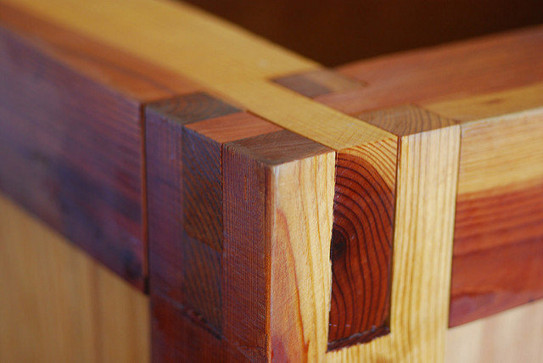
What is a wood working joint?
Is a connection between two pieces of wood.
Many variations

Slide 3
Wooden Joints in this class
Butt Joints
Dowel Joints
Biscuit Joints
Rabbit joints
Dado Joints
Grooves
Miter Joints
Lap Joints
Mortise and Tenon Joints
Splines

Slide 4
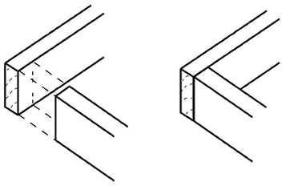
Butt Joints
3 different types
  End
  Edge
  Face
Various combinations
Weak
  Must be reinforced with glue, or screws

Slide 5
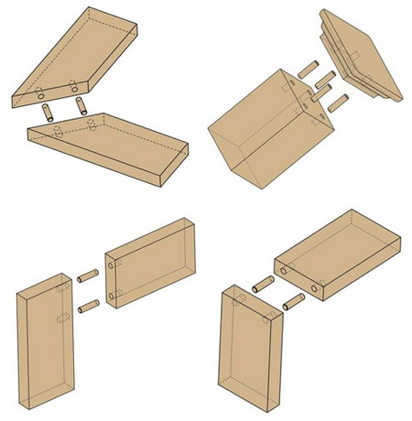
Dowel Joints
Reinforcement for the butt joints
Held together better with glue
Fairly strong, there are strong joints
Must be reinforced with glue.
Great for strengthening miter joints

Slide 6
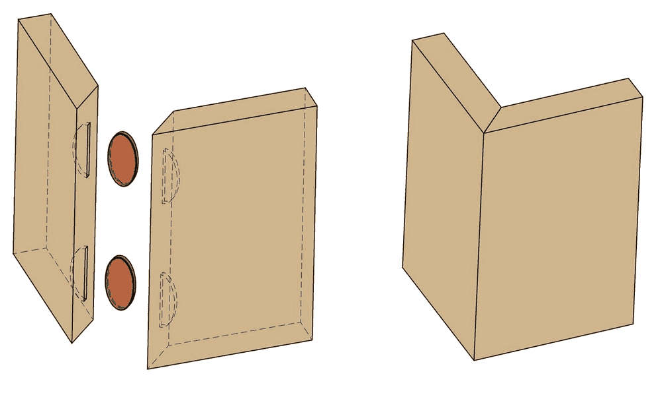
Biscuit Joints
Weak w/o glue
Strong with glue
  biscuit absorbs the moisture in the glue and expands, holding the 2 boards together
Come in many sizes

Slide 7

Rabbit Joint
Not very strong
Must be reinforced with glue and screws
Used on cabinetry and boxes
Cut on the outside edges of boards
Multi grain,
  Cut on any grain direction

Slide 8
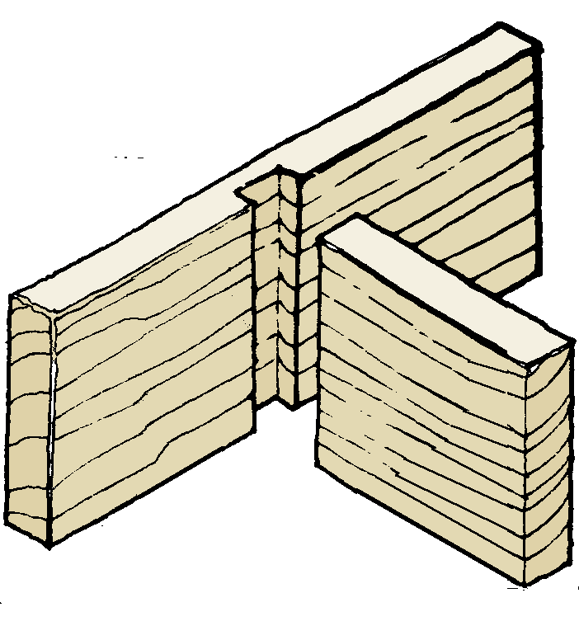
Dado Joints
Very Strong
Need reinforced with glue
Always go across the grain
Used in furniture joints
  Book Shelves
  Tables
  Cabinets

Slide 9
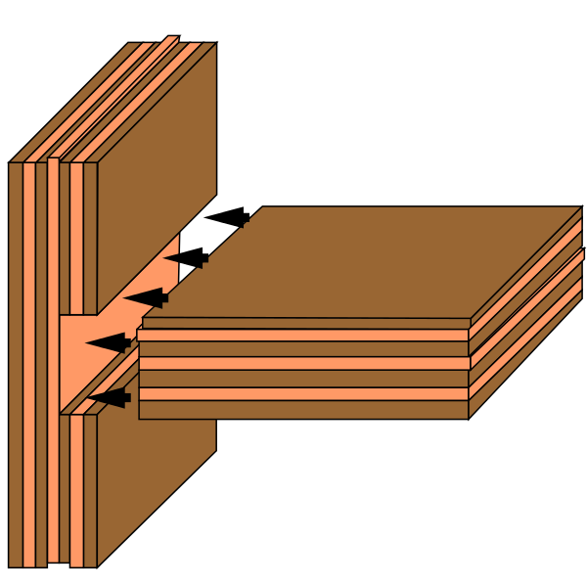
Grooves
Very stong
Like a dado joint
Goes with the grain of a board
Used in furniture, cabinetry
Needs reinforced with glue

Slide 10
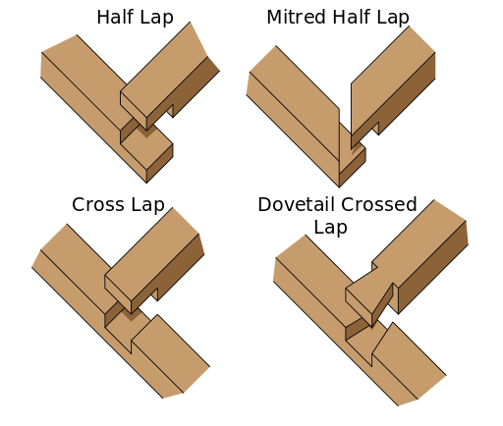
Lap Joints
Many different types
Cross joints between rabbits and dado joints, or dado and dado joints
Strong depending on placement
Reinforced with glue

Slide 11
Miter Joints
Any angled cut across the face of a board through the end grain is a miter.
  End grain is a square 90 degree vertical
Any angled cut with the edge across the end grain is a bevel
  End/Edge grain is angled
Miters and Bevels can be cut on both the chop saw and the table saw.
Set at any angle the machine can cut.
Beveled-miters are a combination of both
  Used for fancy picture frames

Slide 12
Miter Joints Continued
5 common types of miter joints
  3, 4, 5, 6, 8 sided frames
Reinforced with glue, dowels, or biscuits
If angled are off you will have very ugly gaps
90 degree angle = 45 degree miter
60 degree angle = 30 degree miter
109 degree angle = 54.5 degree miter
120 degree angle = 60 degree miter

Slide 13
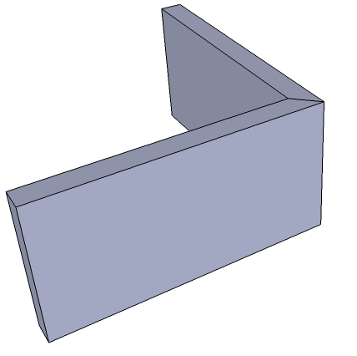
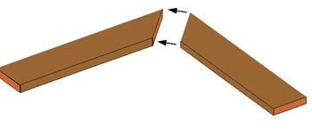
Miter Joint Continued
Miter Joint
Bevel Joint

Slide 14
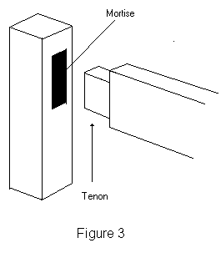
Mortise and Tenon Joints
Square hole – Square Peg
Many variations
- Wedge
- Through
- Half blind

Slide 15
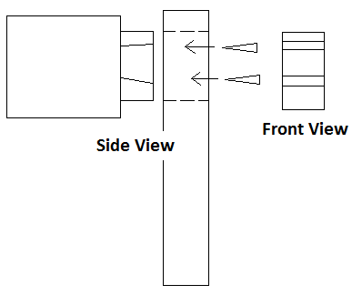
Mortise and Tenon Continued
Wedge Mort + Tenon
  Wedges spread out tenon to “wedge the tenon in place
  Through mortise

Slide 16
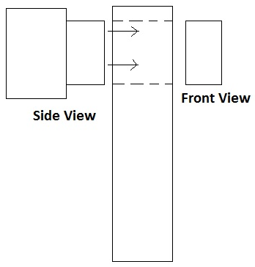
Mortise and tenon continued
Though Mortise and tenon the tenon goes all the way through
  Tenon must match the mortise or else there are gaps

Slide 17
Mortise and Tenon Continued
Half Blind
  Mortise cut first
  Easy to manipulate and repair

Slide 18
Mortise and Tenon Continued
Parts
  Mortise
    Cheek
    Top/Bottom
  Tenon
    Shoulder
    Cheek
    Top/Bottom

Slide 19
Mortise and Tenon Continued
Shoulder – goes all the way around
  Important that it is the same all the way around
Cheek – surface area for glue
Fit in Mort +Ten
  Must be tight cheek to cheek
  Must be tight T/B
Mortise comes first
  Fit the tenon to the mortise
    Unless otherwise specified
    Commonly on through wedge MTs

Slide 20
Mortise and Tenon Last
Mortise cut on the
  Drill press w/ a mortise attachment
  Hollow chisel mortise
Tenons cut on the
  Dado table saw w/ sled
  Router table w/ fence
Clamping
  1 per joint
  Check w/ square

Slide 21
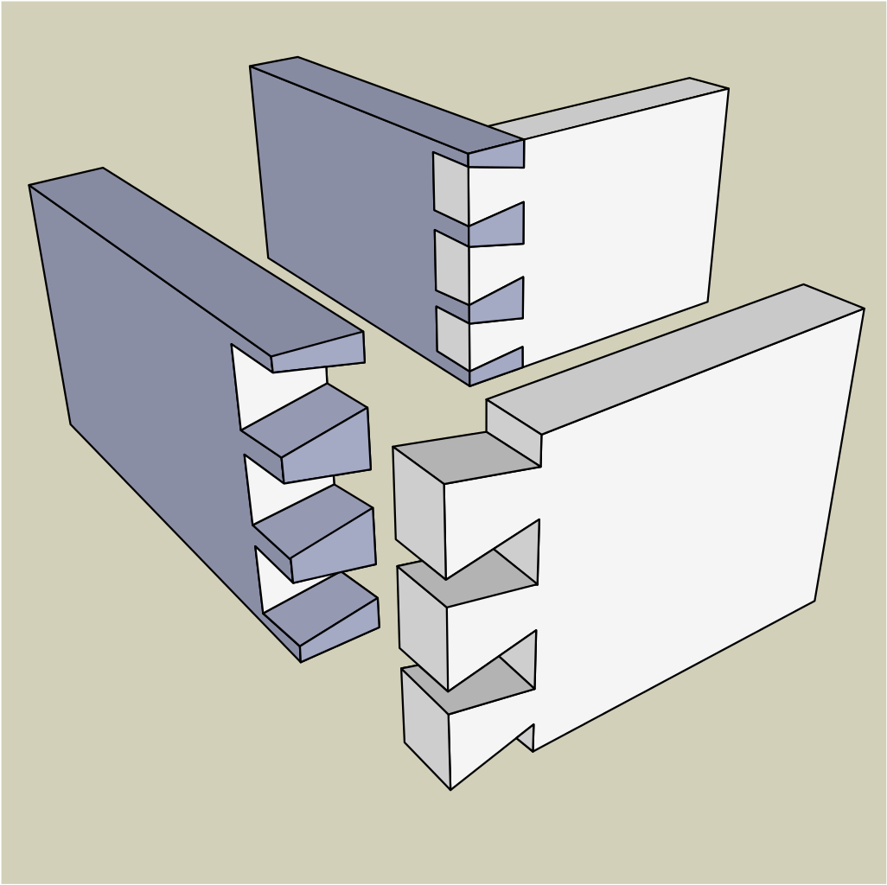
Dovetail joints
Interlocking joints
Consists of tails and pins
Reinforced
  Glue
  Strong w/o glue but glue holds forever

Slide 22
Dovetails Continued
Types of Dovetails
  Blind – can’t see pins
  Full – see the entire joint
Cutting Dovetails
  Blind
    Reverse Dovetail Jig and Router
    Table Saw
    By Hand
  Full
    Table saw
    Router
    By hand
Take more time to layout and get perfect
Clamping
  Band clamps
  4 Bar clamps

Slide 23
Casework
Box turned on end or edge
  Cabinetry
    Shelves
    Tables
    Cabinets
    Boxes
  Fundamentals of jointery
  Creates your furniture
All the joints put together to make 1 piece
  EX. Band saw boxes + but joints
  The case
    Specific to cabinets

